Slide 1
Chapter 5 Concurrency: Mutual Exclusion and Synchronization
Operating Systems: Internals and Design Principles
Ninth Edition
By William Stallings
Notes:
“Operating Systems: Internals and Design Principles”, 9/e, by William Stallings, Chapter 5 “Concurrency: Mutual Exclusion and Synchronization”.

Slide 2
Lecture
This lecture was presented in two parts.
Traditional board lecture
Students were asked and advised to take notes
These Slides
Notes:
For both counting semaphores and binary semaphores, a queue is used to hold processes waiting on the semaphore. The question arises of the order in which processes are removed from such a queue. The fairest removal policy is first-in-first-out (FIFO): The process that has been blocked the longest is released from the queue first; a semaphore whose definition includes this policy is called a strong semaphore . A semaphore that does not specify the order in which processes are removed from the queue is a weak semaphore .

Slide 3

Table 5.3
Common
Concurrency
Mechanisms
Notes:
We now turn to OS and programming language mechanisms that are used to provide concurrency. Table 5.3 summarizes mechanisms in common use. We begin, in this section, with semaphores. The next two sections discuss monitors and message passing. The other mechanisms in Table 5.3 are discussed when treating specific operating system examples, in Chapters 6 and 13 .

Slide 4
Semaphore
A variable that has an integer value upon which only three operations are defined:
There is no way to inspect or manipulate semaphores other than these three operations
A semaphore may be initialized to a nonnegative integer value
The semWait operation decrements the semaphore value
The semSignal operation increments the semaphore value
Notes:
The first major advance in dealing with the problems of concurrent processes
came in 1965 with Dijkstra’s treatise [DIJK65]. Dijkstra was concerned with the
design of an OS as a collection of cooperating sequential processes, and with the
development of efficient and reliable mechanisms for supporting cooperation. These
mechanisms can just as readily be used by user processes if the processor and OS
make the mechanisms available.
The fundamental principle is this: Two or more processes can cooperate by means of simple signals, such that a process can be forced to stop at a specified place until it has received a specific signal. Any complex coordination requirement can be satisfied by the appropriate structure of signals. For signaling, special variables called semaphores are used. To transmit a signal via semaphore s , a process executes the primitive semSignal(s) . To receive a signal via semaphore s , a process executes the primitive semWait(s) ; if the corresponding signal has not yet been transmitted, the process is suspended until the transmission takes place.
To achieve the desired effect, we can view the semaphore as a variable that has an integer value upon which only three operations are defined:
1. A semaphore may be initialized to a nonnegative integer value.
2. The semWait operation decrements the semaphore value. If the value becomes negative, then the process executing the semWait is blocked.
Otherwise, the process continues execution.
3. The semSignal operation increments the semaphore value. If the resulting value is less than or equal to zero, then a process blocked by a semWait operation, if any, is unblocked.
Other than these three operations, there is no way to inspect or manipulate semaphores.
We explain these operations as follows. To begin, the semaphore has a zero or positive value. If the value is positive, that value equals the number of processes that can issue a wait and immediately continue to execute. If the value is zero, either by initialization or because a number of processes equal to the initial semaphore value have issued a wait, the next process to issue a wait is blocked, and the semaphore value goes negative. Each subsequent wait drives the semaphore value further into minus territory. The negative value equals the number of processes waiting to be unblocked. Each signal unblocks one of the waiting processes when the semaphore value is negative.

Slide 5
Consequences
There is no way to know before a process decrements a semaphore whether it will block or not
There is no way to know which process will continue immediately on a uniprocessor system when two processes are running concurrently
You don’t know whether another process is waiting so the number of unblocked processes may be zero or one
Notes:
[DOWN08] points out three interesting consequences of the semaphore definition:
• In general, there is no way to know before a process decrements a semaphore whether it will block or not.
After a process increments a semaphore and another process gets woken up, both processes continue running concurrently. There is no way to know which process, if either, will continue immediately on a uniprocessor system.
• When you signal a semaphore, you don’t necessarily know whether another process is waiting, so the number of unblocked processes may be zero or one.

Slide 6
Strong/Weak Semaphores
A queue is used to hold processes waiting on the semaphore
Strong Semaphores
The process that has been blocked the longest is released from the queue first (FIFO)
Weak Semaphores
The order in which processes are removed from the queue is not specified
Notes:
For both counting semaphores and binary semaphores, a queue is used to hold processes waiting on the semaphore. The question arises of the order in which processes are removed from such a queue. The fairest removal policy is first-in-first-out (FIFO): The process that has been blocked the longest is released from the queue first; a semaphore whose definition includes this policy is called a strong semaphore . A semaphore that does not specify the order in which processes are removed from the queue is a weak semaphore .

Slide 7
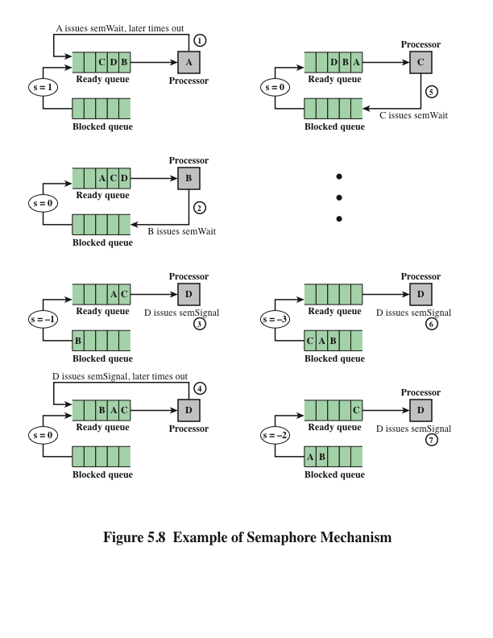
Notes:
Figure 5.8 is an example of the operation of a strong semaphore. Here processes A, B, and C depend on a result from process D. Initially (1), A is running;
B, C, and D are ready; and the semaphore count is 1, indicating that one of D’s results is available. When A issues a semWait instruction on semaphore s , the semaphore decrements to 0, and A can continue to execute; subsequently it rejoins the ready queue. Then B runs (2), eventually issues a semWait instruction, and is blocked, allowing D to run (3). When D completes a new result, it issues a semSignal instruction, which allows B to move to the ready queue (4). D rejoins the ready queue and C begins to run (5) but is blocked when it issues a semWait instruction. Similarly, A and B run and are blocked on the semaphore, allowing D to resume execution (6). When D has a result, it issues a semSignal , which transfers C to the ready queue. Later cycles of D will release A and B from the Blocked state.

Slide 8
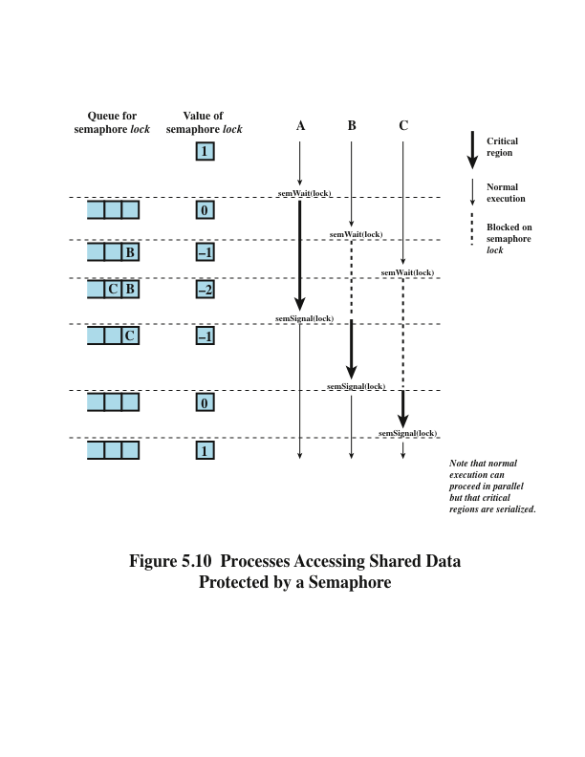
Notes:
Figure 5.10, based on one in [BACO03], shows a possible sequence for three
processes using the mutual exclusion discipline of Figure 5.9. In this example three
processes (A, B, C) access a shared resource protected by the semaphore lock .
Process A executes semWait (lock) ; because the semaphore has a value of 1 at
the time of the semWait operation, A can immediately enter its critical section and
the semaphore takes on the value 0. While A is in its critical section, both B and
C perform a semWait operation and are blocked pending the availability of the
semaphore. When A exits its critical section and performs semSignal (lock) , B,
which was the first process in the queue, can now enter its critical section.

Slide 9
Producer/Consumer Problem
General Statement:
One or more producers are generating data and placing these in a buffer
A single consumer is taking items out of the buffer one at a time
Only one producer or consumer may access the buffer at any one time
The Problem:
Ensure that the producer won’t try to add data into the buffer if its full, and that the consumer won’t try to remove data from an empty buffer
Notes:
We now examine one of the most common problems faced in concurrent processing: the producer/consumer problem. The general statement is this: There are one or more producers generating some type of data (records, characters) and placing these in a buffer. There is a single consumer that is taking items out of the buffer one at a time. The system is to be constrained to prevent the overlap of buffer operations. That is, only one agent (producer or consumer) may access the buffer at any one time. The problem is to make sure that the producer won’t try to add data into the buffer if it’s full and that the consumer won’t try to remove data from an empty buffer. We will look at a number of solutions to this problem to illustrate both the power and the pitfalls of semaphores.

Slide 10
Student
Complement with info from the book
Read it

